Slide 1

PFL data collection – hands on session
Finding and re-using research data workshop UCD Health Sciences Library, 15th June 2017
Session 14:00 – 15:30
Ruth Geraghty
Data Curator
Children’s Research Network

Slide 2
Overview of this session
Presentation and Q&A with Ailbhe Booth, member of the PFL evaluation team at UCD Geary (about 30 mins)
Guided hands on session with a subset of data from archived PFL collection using SPSS – chance to see inside an archived collection (about an hour)

Slide 3
1. Recap of the Preparing for Life collection
Recap of this collection

Slide 4
Preparing for Life collection: Evaluation of the Preparing for Life early childhood intervention (PFL), 2008 – 2015
Study number (SN): 0055-00
Where can I find out more about this collection?
https://www.ucd.ie/issda/data/pfl/
Where can I find out more about the PEI Research Initiative?
http://www.childrensresearchnetwork.org/knowledge/collection/prevention-and-early-intervention
Data should always be cited in any new work. Use the following:
Northside Partnership; Orla Doyle; UCD Geary Institute PFL Evaluation Team (2017). Preparing for Life collection: Evaluation of the Preparing for Life early childhood intervention, 2008 - 2015. [collection]. Version 1. Dublin: Irish Social Science Data Archive [distributor ] SN: 0055-00. ucd.ie/issda/pfl

Slide 5
Preparing for Life collection: Evaluation of the Preparing for Life early childhood intervention (PFL), 2008 – 2015 Study number (SN): 0055-00
How do I get the full PFL collection?
To access the data, please complete a request form for research purposes, sign it, and send it to ISSDA by email.
Data will be disseminated on receipt of a fully completed, signed form. Incomplete or unsigned forms will be returned to the data requester for completion.

Slide 6
Recap on PFL intervention and evaluation
Operated by Northside Partnership in Dublin
Objective: improve levels of school readiness of young children from several disadvantaged areas in North Dublin
Intervention: pregnancy to age 4 (school entry)
UCD Geary Institute (Dr. Orla Doyle)
2008 – 2015
7 waves of data collection:
  prenatal baseline, 6 months, 12 months, 18 months, 24 months, 36 months, 48 months
Mixed methods approach
  Impact evaluation, implementation analysis, process evaluation, direct observation of children using British Ability Scale at school entry
Randomisation into low support and high support, plus a comparison community (LFP)
What we’ll look at today

Slide 7
Domains examined by PFL
EIGHT DOMAINS
Child development
Child health
Parenting
Home environment
Maternal health and wellbeing
Social support
Childcare and service use
Household factors and socioeconomic status
What we’ll look at today

Slide 8
2. Starting out
A run through of the basic features of the archived file

Slide 9
Contents of the archived file
Data: The archived dataset (in the case of PFL 1 data file per wave)
Survey: The survey instrument used to gather data (in the case of PFL 1 survey per wave). Copyrighted scale material may be redacted from the archived version, but where this occurs a citation for the scale is provided.
Codebooks: The codebook lists all variables in the archived dataset with some basic frequencies (in the case of PFL a codebook for each wave). This codebook was created during the archiving process. Look at the index at the end for a quick reference list of all variables in a data file.
Report: The published evaluation report by the researchers that created this dataset (in the case of PFL 1 report per wave)

Slide 10
Please check that you have the following four folders
Files for workshop 15 June
BL
12m
24m
48m

Slide 11
Inside each folder check you have these files (includes contextual materials)
BL folder
PFL_BL_Data-sample
PFL-BL-Codebook
PFL-BL-Report
PFL-BL-Survey
12m folder
PFL_12m_Data-sample
PFL-12m-Codebook
PFL-12m-Report
PFL-12m-Survey
24m folder
PFL_24m_Data-sample
PFL-24m-Codebook
PFL-24m-Report
PFL-24m-Survey
48m folder
PFL_48m_Data-sample
PFL-48m-Codebook
PFL-48m-Report
PFL-48m-Survey

Slide 12
Check you can open each of these in SPSS
PFL_BL_Data-sample = pre-natal interview with expectant mother
PFL_12m_Data-sample = interview with mother when child was 1 year old
PFL_24m_Data-sample = interview with mother when child was 2 years old
PFL_48m_Data-sample = interview with mother when child was 4 years old (final interview)
The archival version was processed, including anonymisation of potentially identifying information

Slide 13
3. Using SPSS
Getting started in SPSS

Slide 14
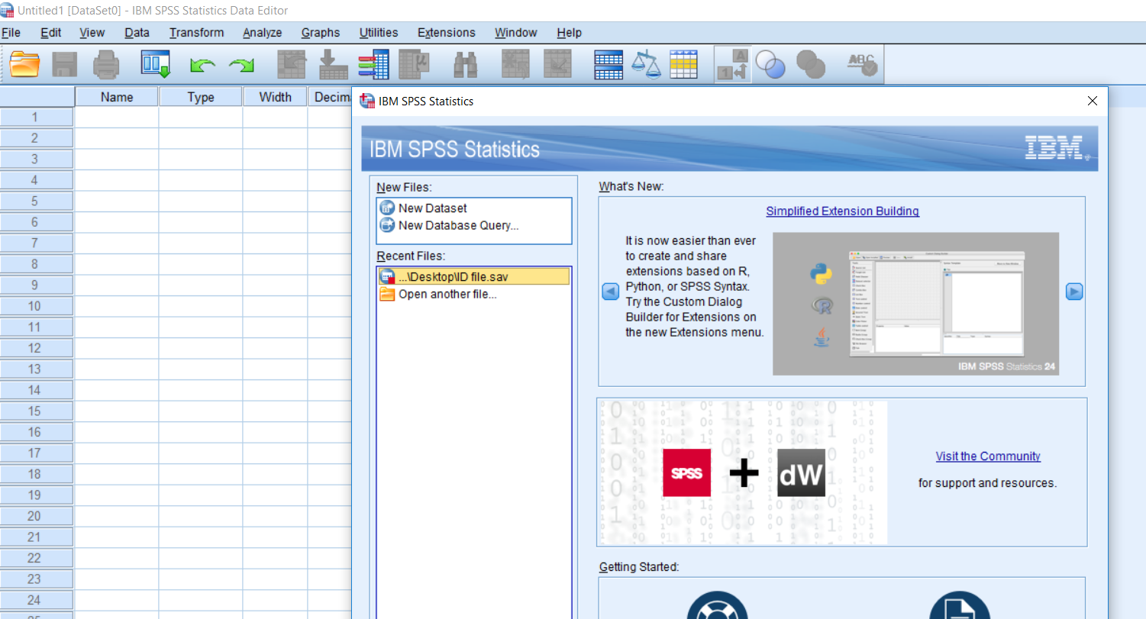
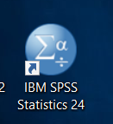
Opening SPSS
1. IBM SPSS Statistics 24
2. Select ‘Open another file’ option

Slide 15
Opening SPSS
3. Navigate to the PFL files on your machine
  PFL_BL_Data-sample.sav
  PFL_12m_Data-sample.sav
  PFL_24m_Data-sample.sav
  PFL_48m_Data-sample.sav
Double click each to open in SPSS
You can keep all 4 PFL files open simultaneously

Slide 16
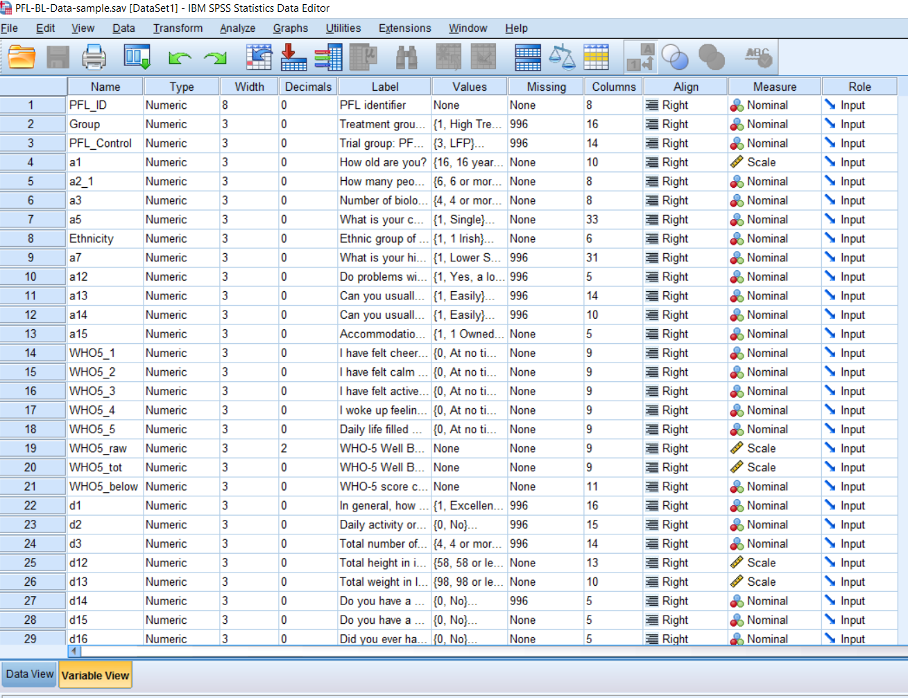
Variable view

Slide 17
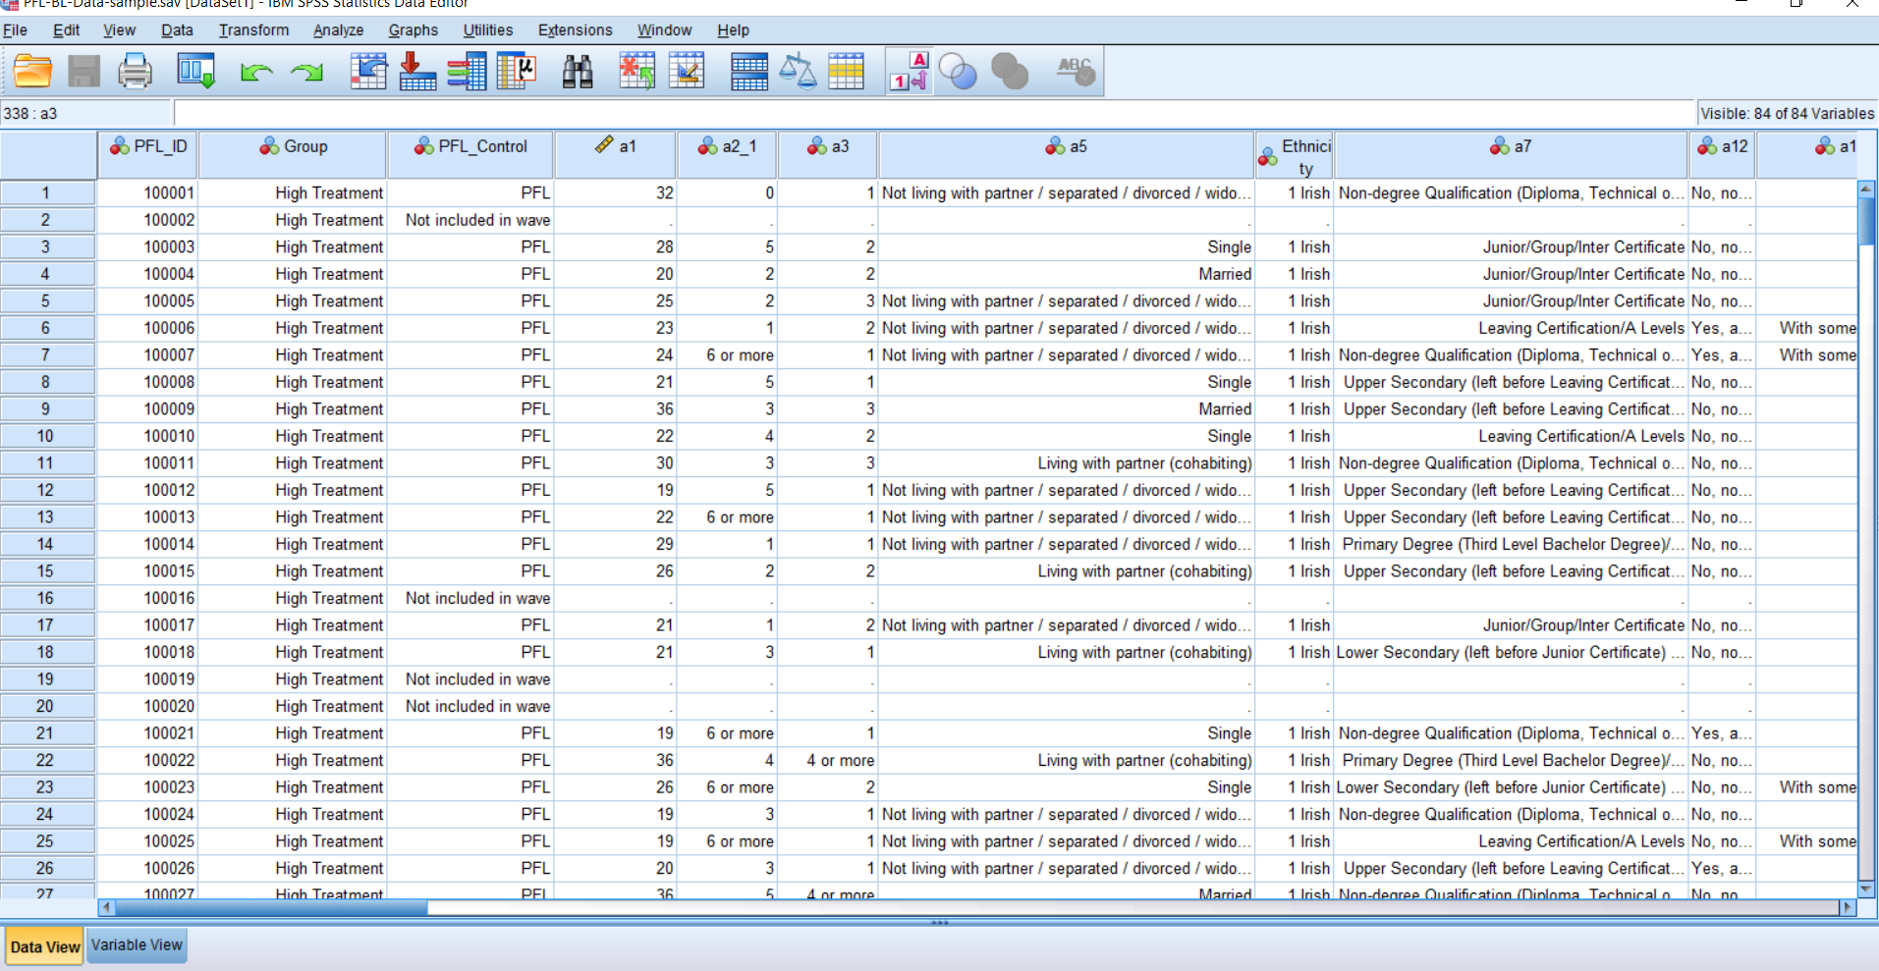
Data view

Slide 18
4. Working with the data files
A little bit of light analysis using SPSS

Slide 19
Please note!
You are working with a sample of the data file
Use the codebook to get an indication of the full set of variables in each wave
But you are only able to see a sub-set today – codebook lists full archival dataset
Data should not be copied or saved onto another device, or taken out of this room
Codebooks, User Guide, Surveys and Reports are openly available on ISSDA website
If you would like to access this data please apply through ISSDA

Slide 20
Variable naming conventions of PEI-RI project
Survey variables: Variables that were generated by the survey correspond to the question number in the survey, and are labelled to correspond as closely as possible to the original wording of the survey question. Labels are sometimes composed from truncated survey questions due to character restrictions in the software (see below).
In 24m data file: scroll down to variables d4, d5, d7, d8, d10 – compare these to the 24m survey
Derived variables: Variables that were created during data entry and analysis
In 24m data file: scroll down to poor_eating (v46) – this was derived from the previous questions ‘How often does baby eat (v39-45)
Anonymisation variables: Variables that were created during anonymisation
In 24m data file: scroll down to d4 What is your current relationship status (v48) – this was recoded into broader categories

Slide 21
Variable naming conventions of PEI-RI project
Scale variables: Individual scale items, domain scores and total scores are named with the scale acronym which is capitalised for ease of reference . These acronyms are consistent across all waves to facilitate the user to track specific measures across waves. A full list of scale acronym and their full title and citation are available in Appendix 3. Where permission has been granted to reproduce the scale contents in the archive, items are labelled so that they correspond as closely as possible to the wording of the survey question. Where this permission has not been granted, individual item are labelled with the scale title and sequence number.
In 24m data file: scroll down to CDI_baabaa McArthur-Bates CDI Toddler short – form A (v73 onwards) to see scale items, and total scores

Slide 22
Conventions of PEI-RI project: Missing cases are included
Why are there missing cases? All 332 cases are included in the data file for each wave, so that individual wave files can be merged together if required. However, data was not collected for every case at each data collection point and consequently there are a small number of missing cases per wave. Missing cases in the data file are indicated by the system missing count and by the variable PFL_control. A count of missing cases per wave is also provided at the start of the codebook for ease of reference.
Using the 12m file, run a frequency using the variable Trial Group: PFL intervention or control [PFL_Control]
Method: Analyze / Descriptive Statistics / Frequencies
Result: 82 in LFP, 165 in PFL and 85 not included in wave

Slide 23
Conventions of PEI-RI project: Missing data
Why are there missing data? While participants were encouraged to answer all questions during the interview, there were some instances where a participant either could not provide a response to a question or did not wish to provide a response. Missing data are included in the archived dataset (marked as missing or left blank) so that new users can manage missing data in a manner that best suits their research design.
Non-response codes for categorical variables:
996 = missing
997 = not applicable
998 = refuse
Missing data for scales: Calculation rules for missing scale items are provided in Appendix of user guide. Users should refer to the codebook for specific information on the calculation of cut off points.

Slide 24
Merging wave files
Same cases included in all waves (even where data not collected)
Two files can be match using ID variable – make sure they are both in ascending order (or at last the same order)
Data / Merge files/ Add variables
  Excluded variables = variables that are common to both files
  New Active Dataset = variables that will be included in new file
  Tick Match cases on key variables and add PFL_ID to the Key Variables box
Try merging the BL and 12m file together

Slide 25
5. Demographic and health variables
A sample of variables from PFL

Slide 26
Household demographic variables
Age
Ethnicity
No of children (first time mother)
Highest level of education
Literacy
Current work status / change to work status
Social housing
Medical card, GP card
Health insurance
Social welfare payments
Financial difficulty (self-assess)
Household income (equivalised – anon)
Household size (equiv size – anon)
EU-SILC material deprivation

Slide 27
Maternal health behaviour variables
Baby’s health:
Baby age, gender, weight, height
Health over last 6 months
Immunisations
Breastfeeding / child’s eating
Child’s sleep behaviours
TV and screen time
Mother’s health:
Physical activity
Substance use
WHO5
Subjective health assessment

Slide 28
Standardised measures – a small sample for review
24m file
McArthur Bates – just 10 items as sample
CBCL – just 10 items as sample
48m file
Child’s sleeping habits (CSH) – full scale

