Slide 1


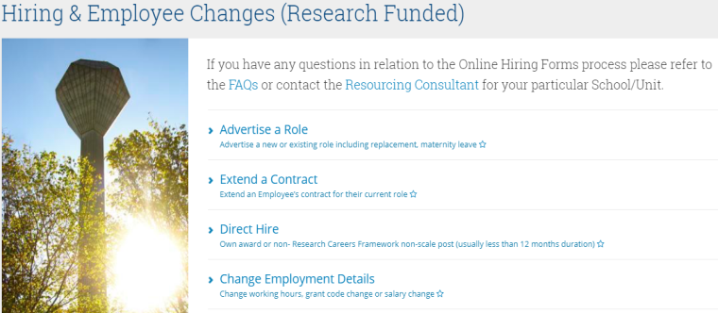
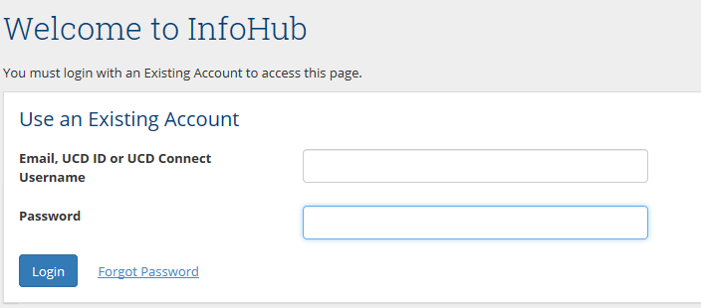
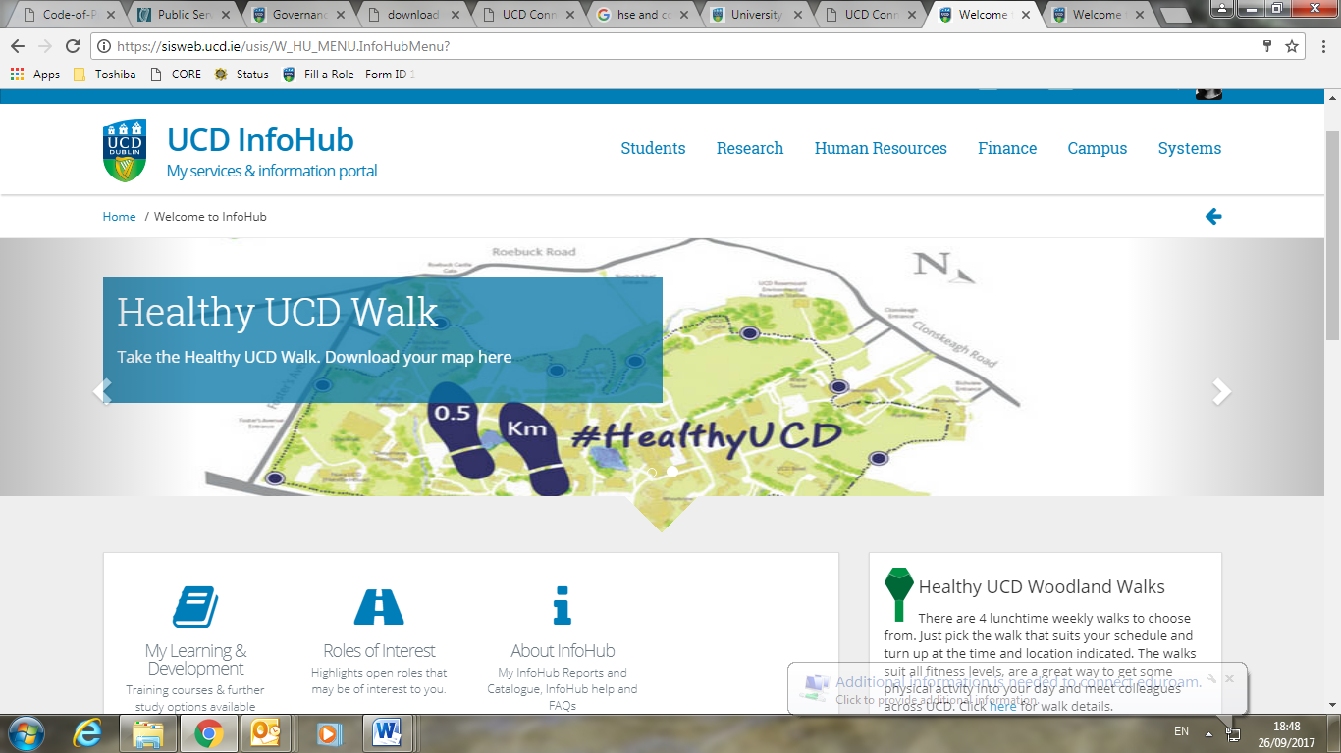
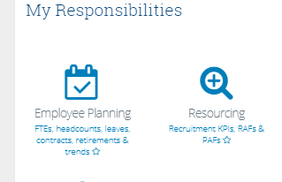
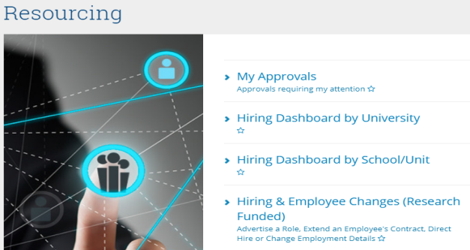
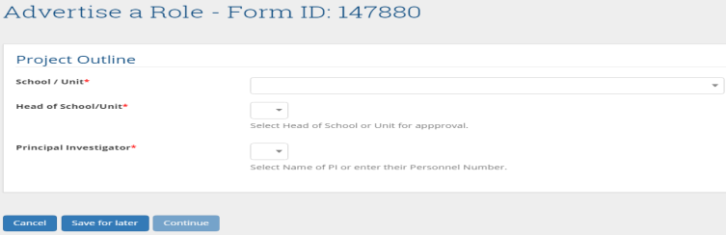

UCD Online Hiring Form User Guide School/Unit/Institute- Creator
1. School or unit log in
2. Select 1 of the 4 options either Advertise a Role, Extend an Employee’s Contract, Direct Hire or Change Employment Details.
Go to www.ucd.ie/infohub
Log in using your Staff Personnel Number, UCD Username or email
Funding- please note you can proceed to advertise a role if a grant code is currently in the process of being setup. You cannot, however, proceed with a direct appointment or an extension if the grant code/project funding is not in place.
Duration- Enter either an estimated duration in months (i.e. for maternity cover or research fellows) or enter a fixed end date if known (i.e. for project work).
Validate- You need to click on “Check Name” to validate an employee’s details.
Upload- You must upload the relevant Job Description and logos where applicable.
Save for Later-You can access the form again and the data can be edited in the “My Approvals” screen.
Cancel- Only the creator of the form can cancel the form. By clicking cancel the form is deleted and can’t be restored.
My Approvals- The “My Approvals” section can be used to track the progress of forms which have been submitted to the next approver.
Click on Human Resources
3. Follow each step on the form and click on continue to proceed.
Select the Resourcing Icon
Note the Form ID is the unique identifier throughout the process.
Please select the Head of School/Unit, the Prinicipal Investigator, the reason type (new post/resignation etc.) and post status (e.g. temporary full-time or part-time in order for the form to regenerate).
Please consult with the Principal Investigator in relation to the post before submitting a form. If you are awaiting clarification on particular details you can use the save for later function in order to return to the form once you are ready to submit.
2. Select Hiring and Employee Changes (Research Funded)
Hiring Forms FAQs
Resourcing Consultant Contact Details
Research Finance Office Contact Details

