Slide 1

What is Computer Science?

Slide 2
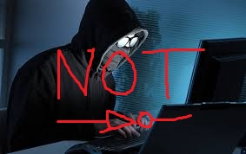
Hacker image

Slide 3
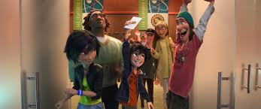

Computer Science community

Slide 4
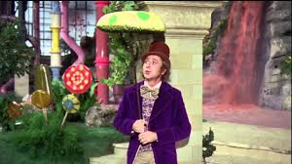
Hacker attitude: The world is full of fascinating problems

Slide 5




Hacker attitude:No problem should ever have to be solved twice
You could be solving so many of the other fascinating problems instead of doing something that has already been done.
When you solve a problem, you create a path, stepping stone that others can follow. They can trace your steps instead of having to repeat the same process that you did. This is what we like to call redundancy in Computer Science.
There are significant and real applications of this…

Slide 6

Hacker attitude: Boredom and drudgery are evil.
Nobody who can think should ever be forced into a situation that bores them.
“It had long since come to my attention that people of accomplishment rarely sat back and let things happen to them. They went out and happened to things.” – Leonardo Da Vinci

Slide 7
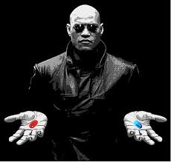
Hacker attitude: Freedom is good
“Learning never exhausts the mind” – Leonardo Da Vinci

Slide 8

Hacker attitude: Attitude is no substitute for competence
People’s lives depend on you. Literally.
Billions of people will be affected by what you do. LITERALLY BILLIONS.
Need to know your stuff very well because there is a lot at stake.

Slide 9
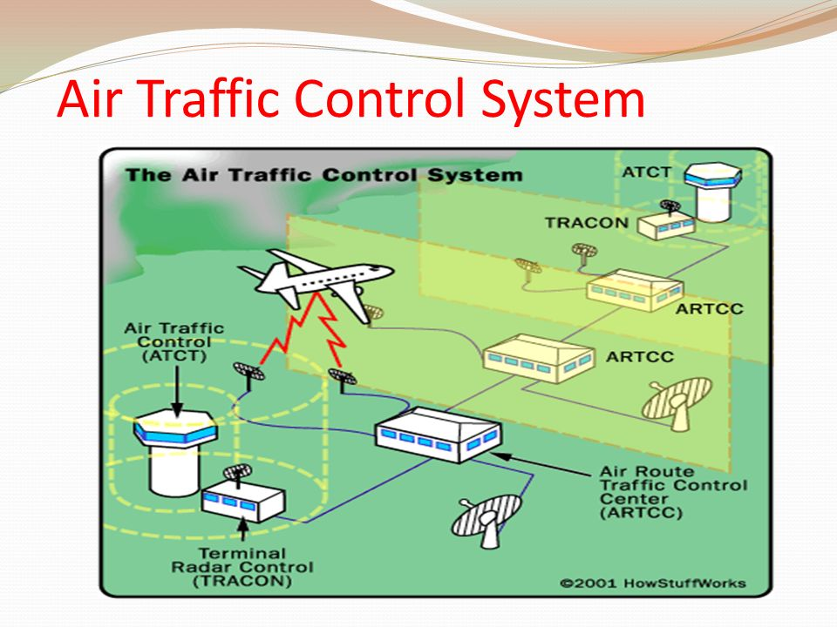
Societal impact: Air traffic control System
If you don’t set your mathematical model up correctly to automate the process then there will be many crash landings.

Slide 10
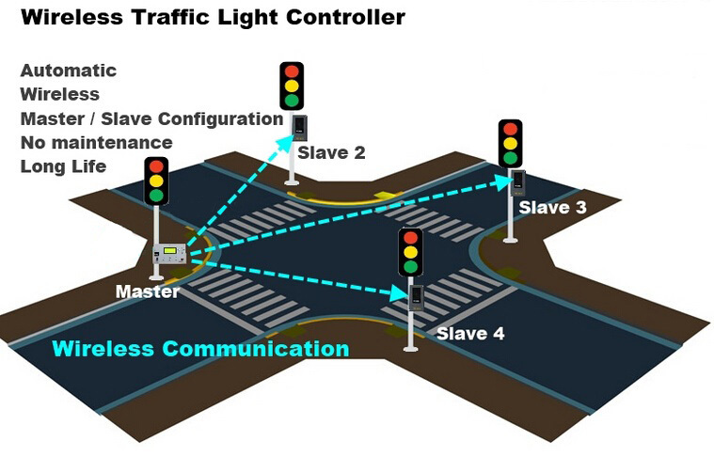
Societal impact: Traffic light controller
If you implement the incorrect logic there will be many accidents on roads.

Slide 11
Societal impact: Social media
Social media networks have their foundation in graph theory.

Slide 12
Societal impact: Mapping software
If google maps were not configured correctly then people would be lost in the middle of nowhere.

Slide 13
Societal impact: Queueing
This functionality allows people to wait for only a matter of seconds before web pages load. This is how Google are able to handle billions of server requests without their servers going down. This is also how online shopping works.

Slide 14
Societal impact: Text-to-speech analysis
You can give a voice to somebody who doesn’t have one.

Slide 15
Societal impact: Big data and bots
Did you know that robots write the news?

Slide 16
Societal impact: Robots
Car manufacturing is now an automated process.

Slide 17
Societal impact: Big data and sensors

Slide 18
Farewell
Before you can help anyone else, you need to help yourself and you will be doing that by moving on to 3rd level. We move to 3rd level so that we can learn the fundamentals which help us make these large societal impacts. This is true regardless of which course you choose or university you go to.
You are in transition year now and this is what it’s for. You have embraced the hacker attitude by coming to CS sparks .You are making good use of your time.
We hope you enjoy the CS Sparks program we have prepared for you. We wish you the best of luck in any discipline you choose or university you go to.
Be curious.

Slide 19
References
http://www.catb.org/esr/faqs/hacker-howto.html This is the link to the article “How To Become A Hacker” written by Eric S. Raymond.
The imitation Game
Hidden Figures
The Social network
The Internship
Mr. Robot
https://www.youtube.com/watch?v=CMm_XL3Ipbo This is the link to Lee Ridley’s voice by choice.

